Slide 1
scholarsphere
Group 20

Slide 2
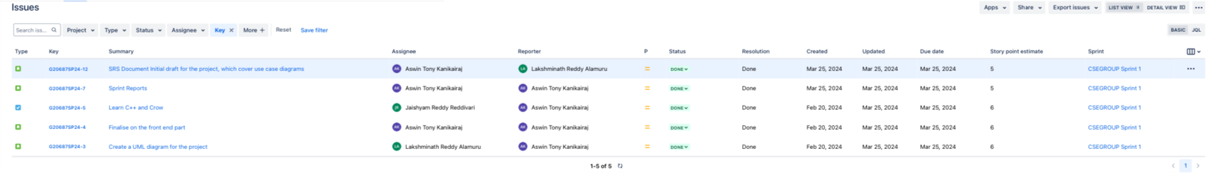
Sprint 1

Slide 3
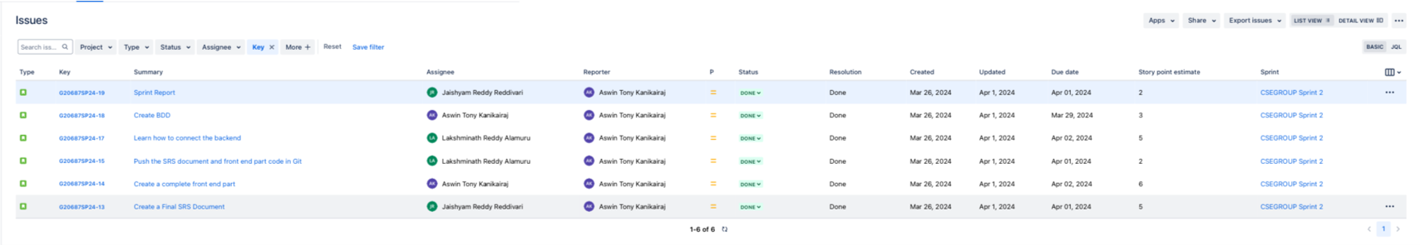
Sprint 2

Slide 4
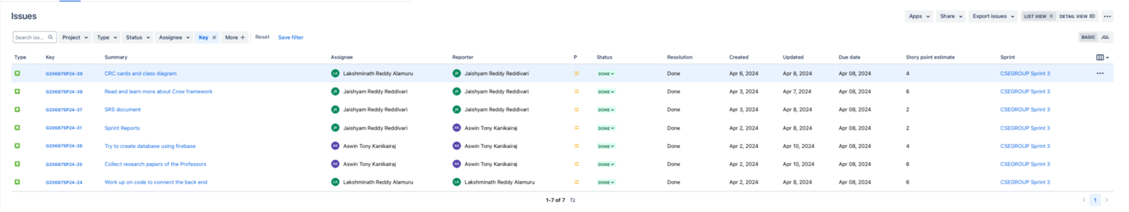
Sprint 3

Slide 5
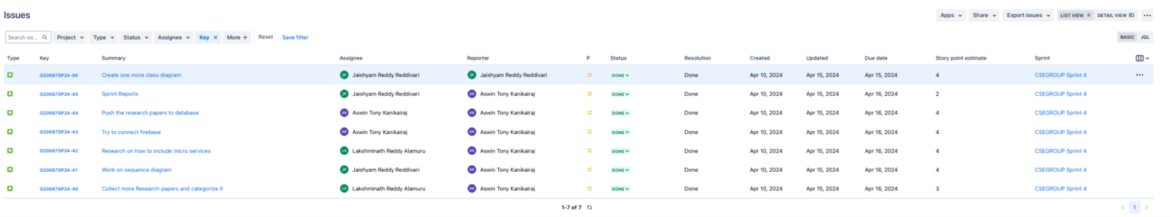
Sprint 4

Slide 6
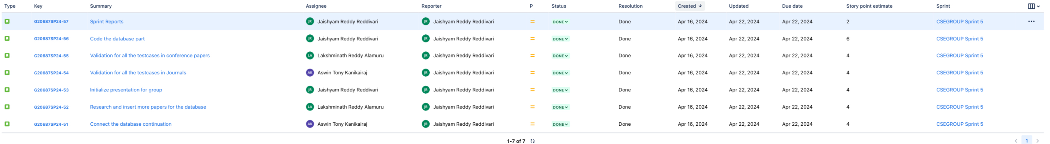
Sprint 5

Slide 7
Sprint 6

Slide 8
Sprint 7

Slide 9
Sprint Overview
Sprint | Number of stories closed | Number of stories rolled over | Story points
Sprint 1 | 5 | 0 | 28
Sprint 2 | 6 | 0 | 23
Sprint 3 | 7 | 0 | 30
Sprint 4 | 7 | 0 | 26
Sprint 5 | 6 | 0 | 29
Sprint 6 | 7 | 0 | 20
Sprint 7
The average number of closed stories per sprint are 6.3.
The average number of stories rolled over are 0.
The total number of story points that the team has logged are 156.

Slide 10
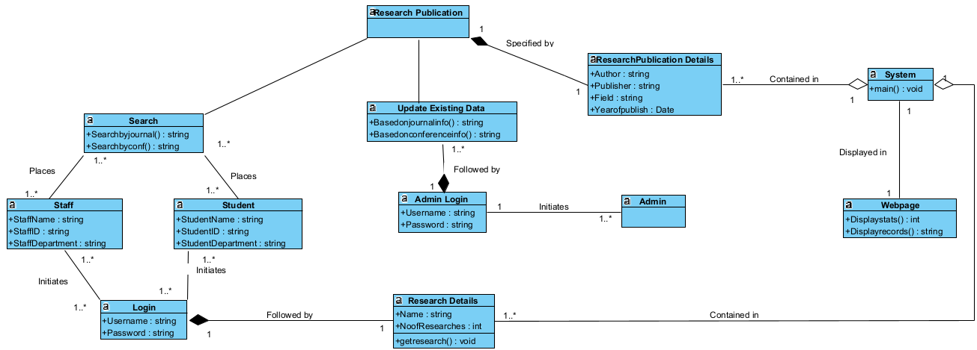
Class Diagram 1

Slide 11
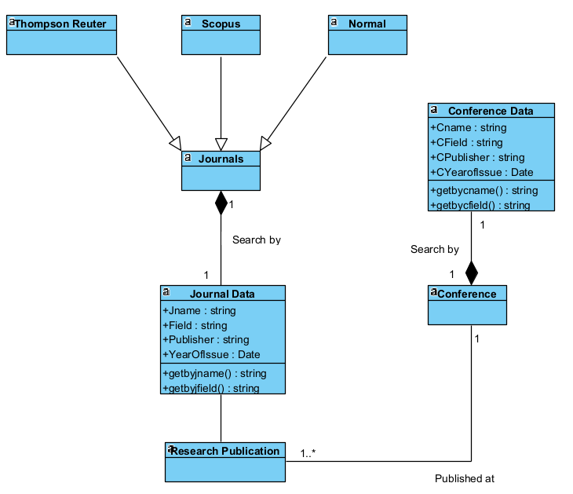
Class Diagram 2

Slide 12
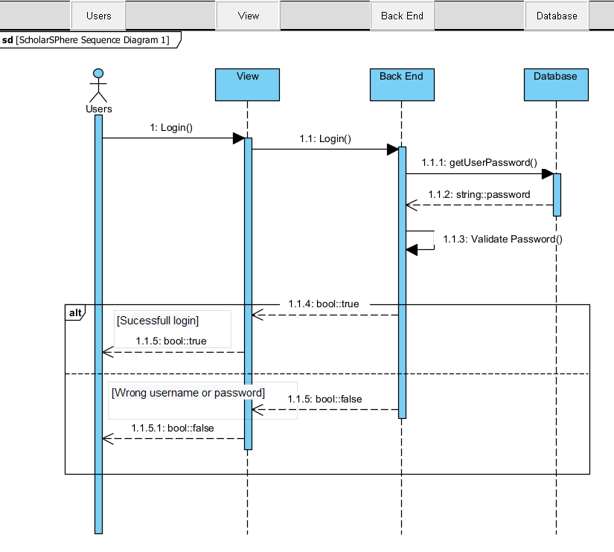
Sequence Diagram 1

Slide 13
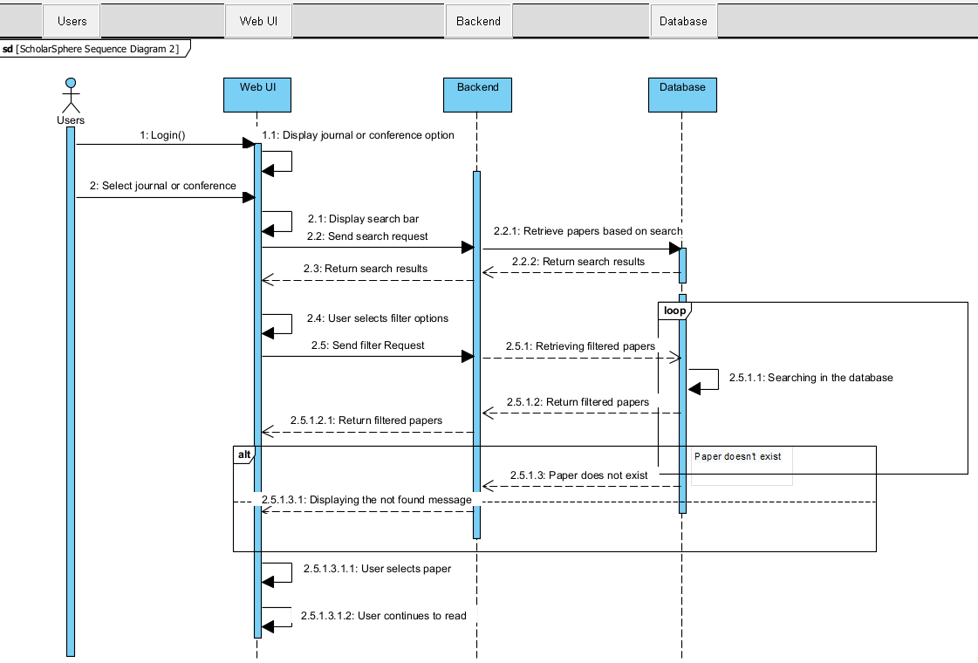
Sequence Diagram 2

Slide 14

ScholarSphere WebPage
Login Page:

Slide 15


User Interface:

Slide 16

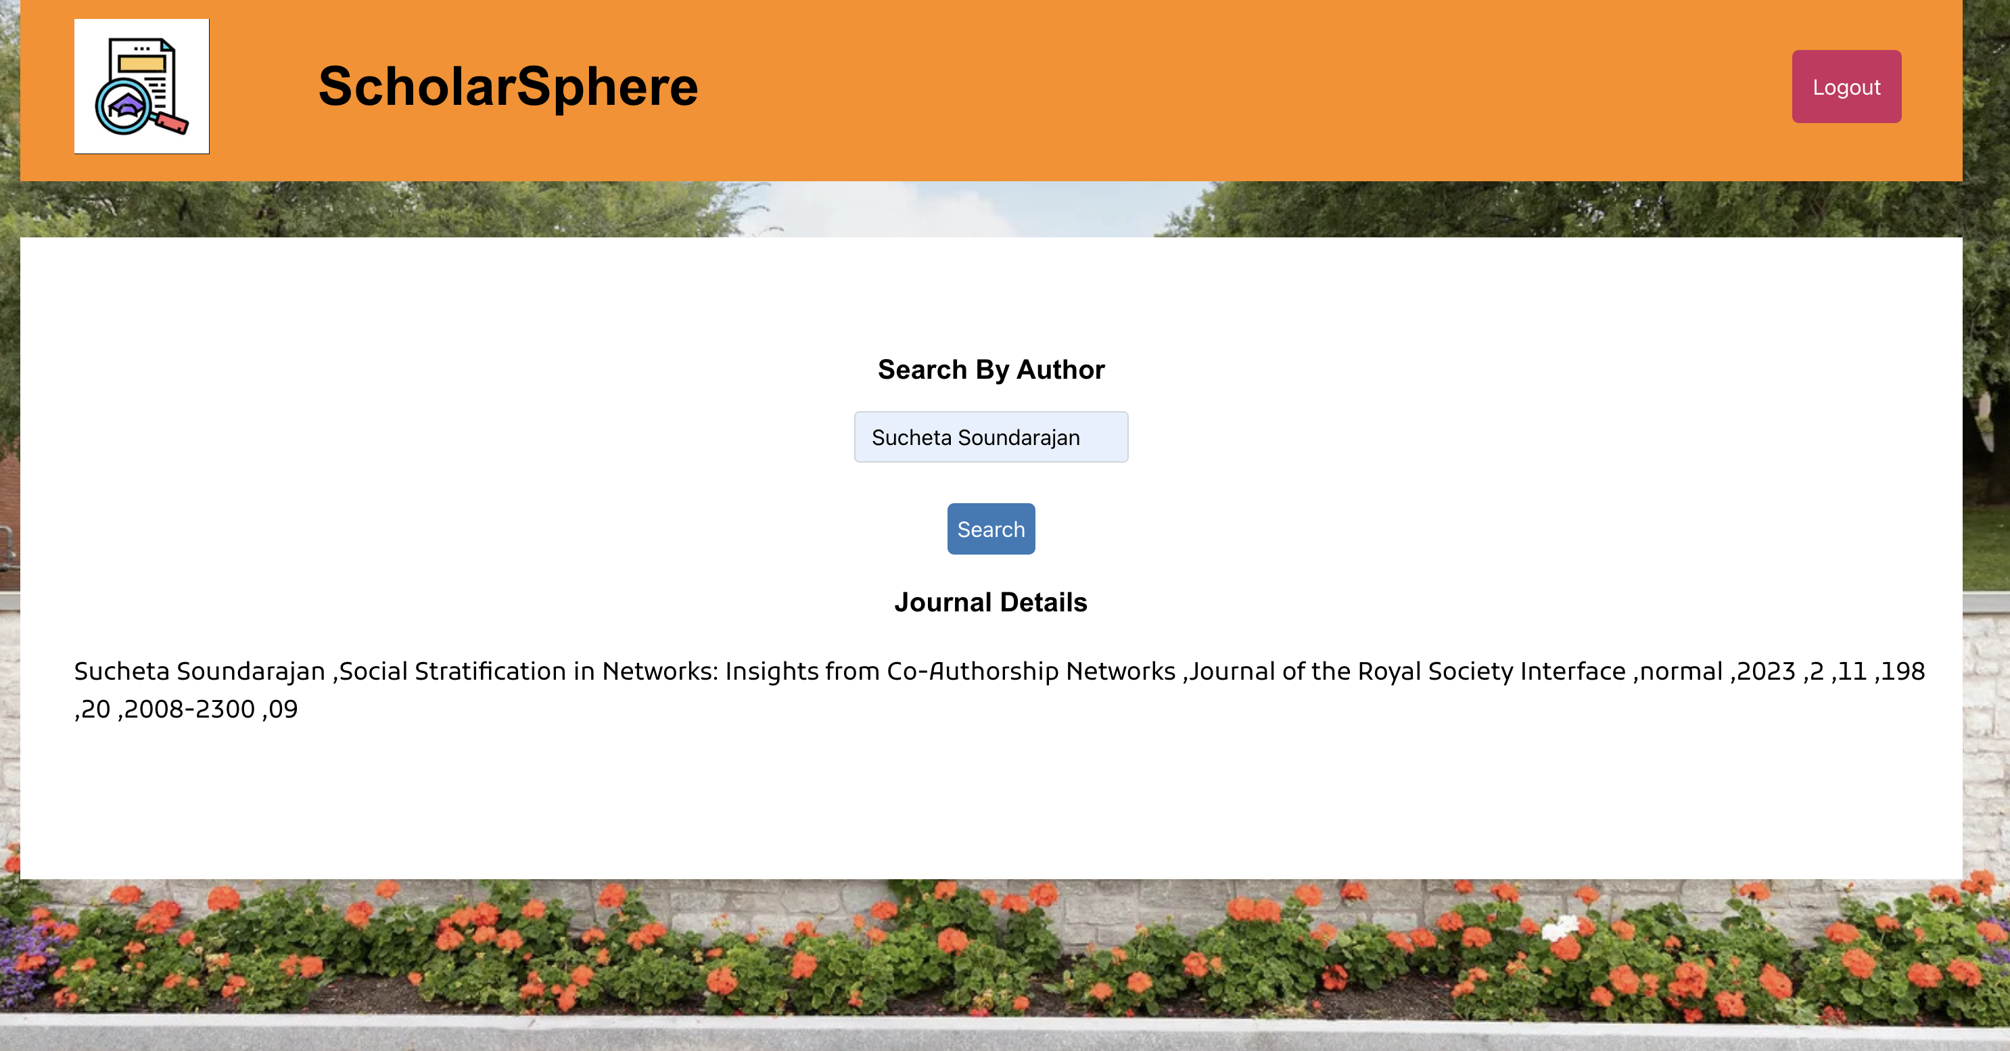

Slide 17

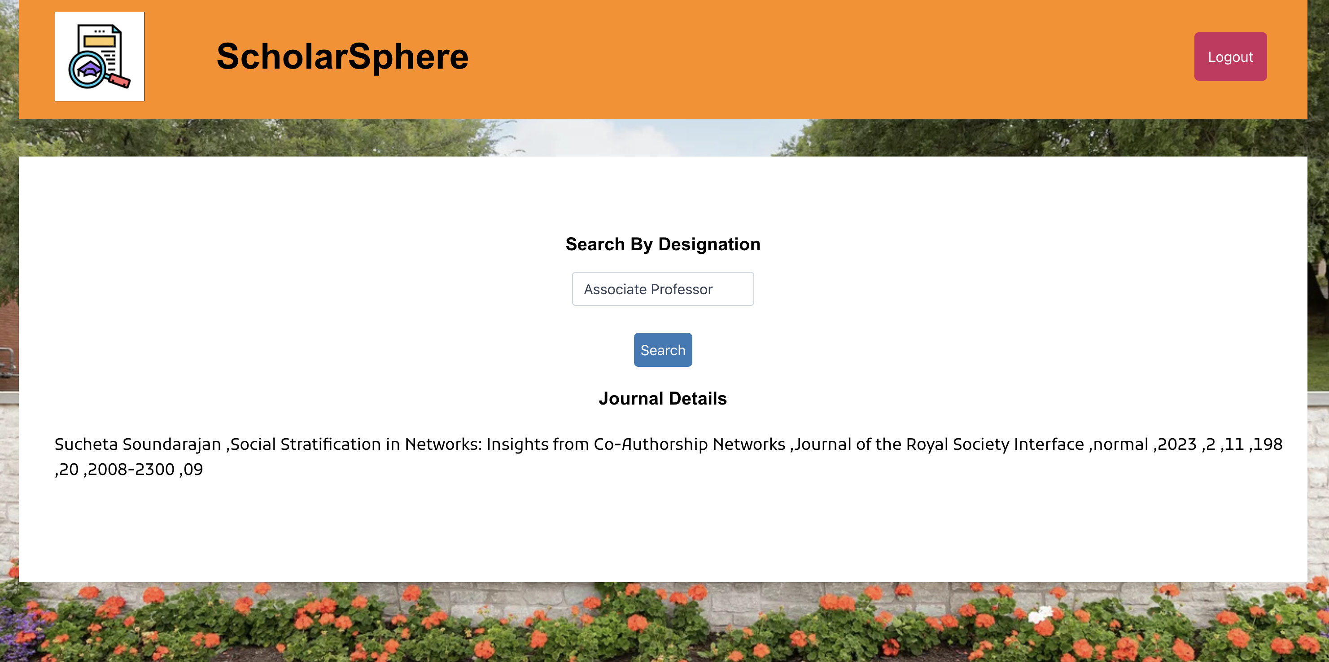

Slide 18


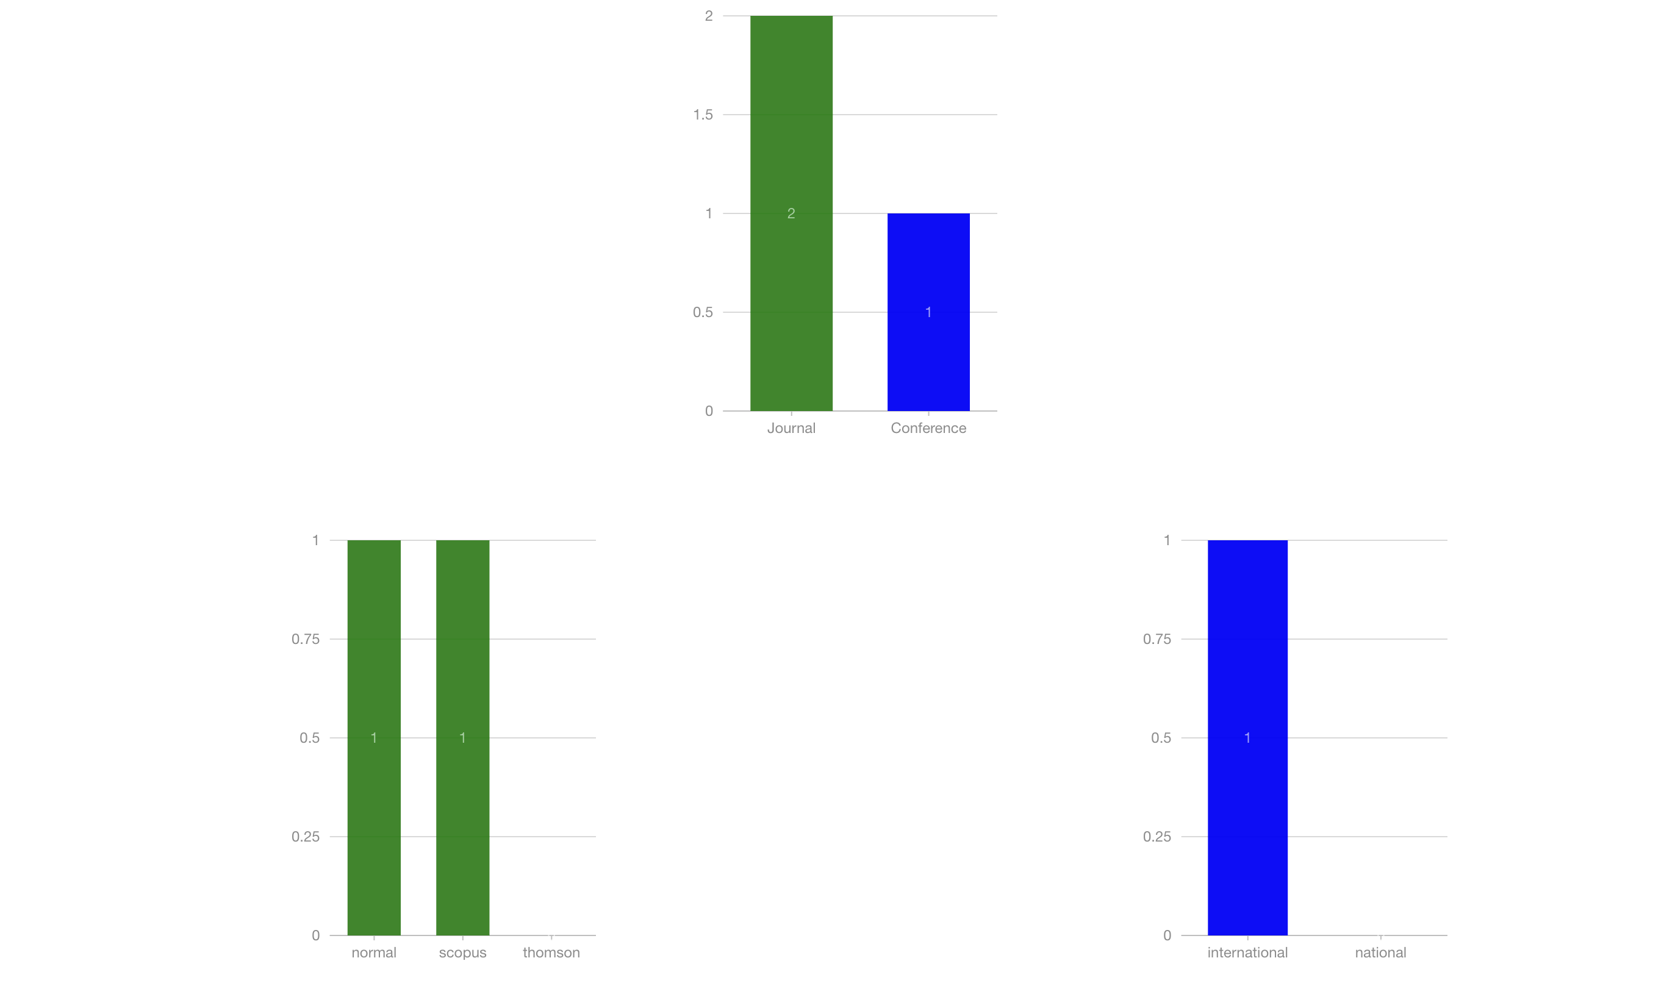
Admin Interface:

Slide 19

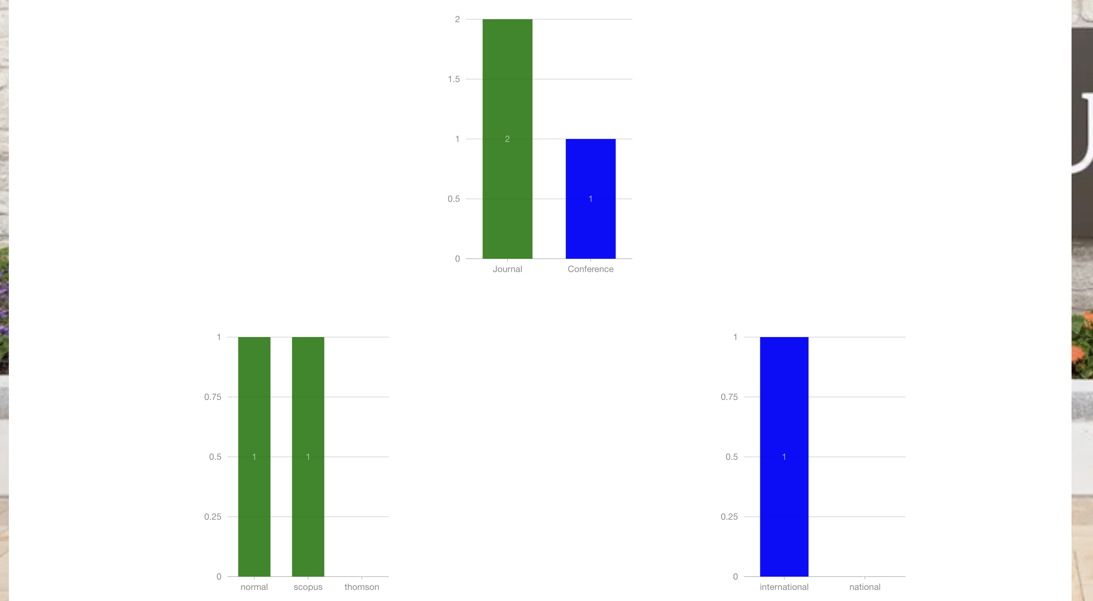

Slide 20

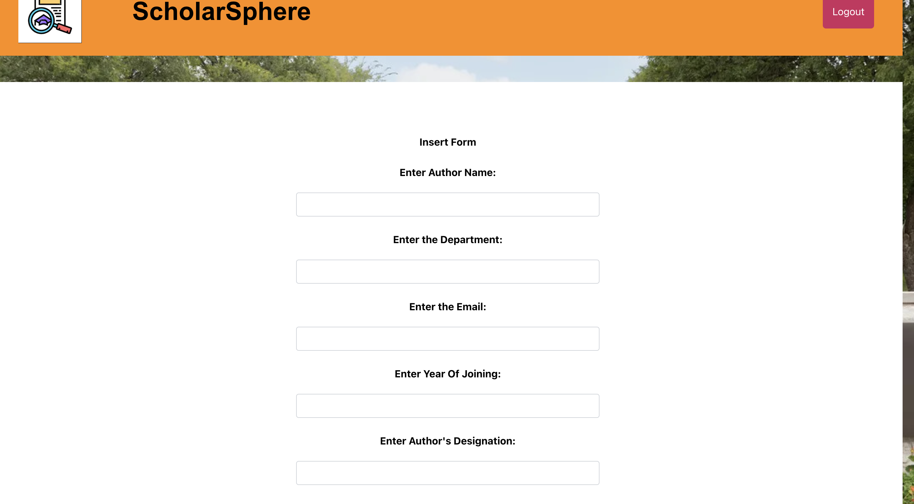
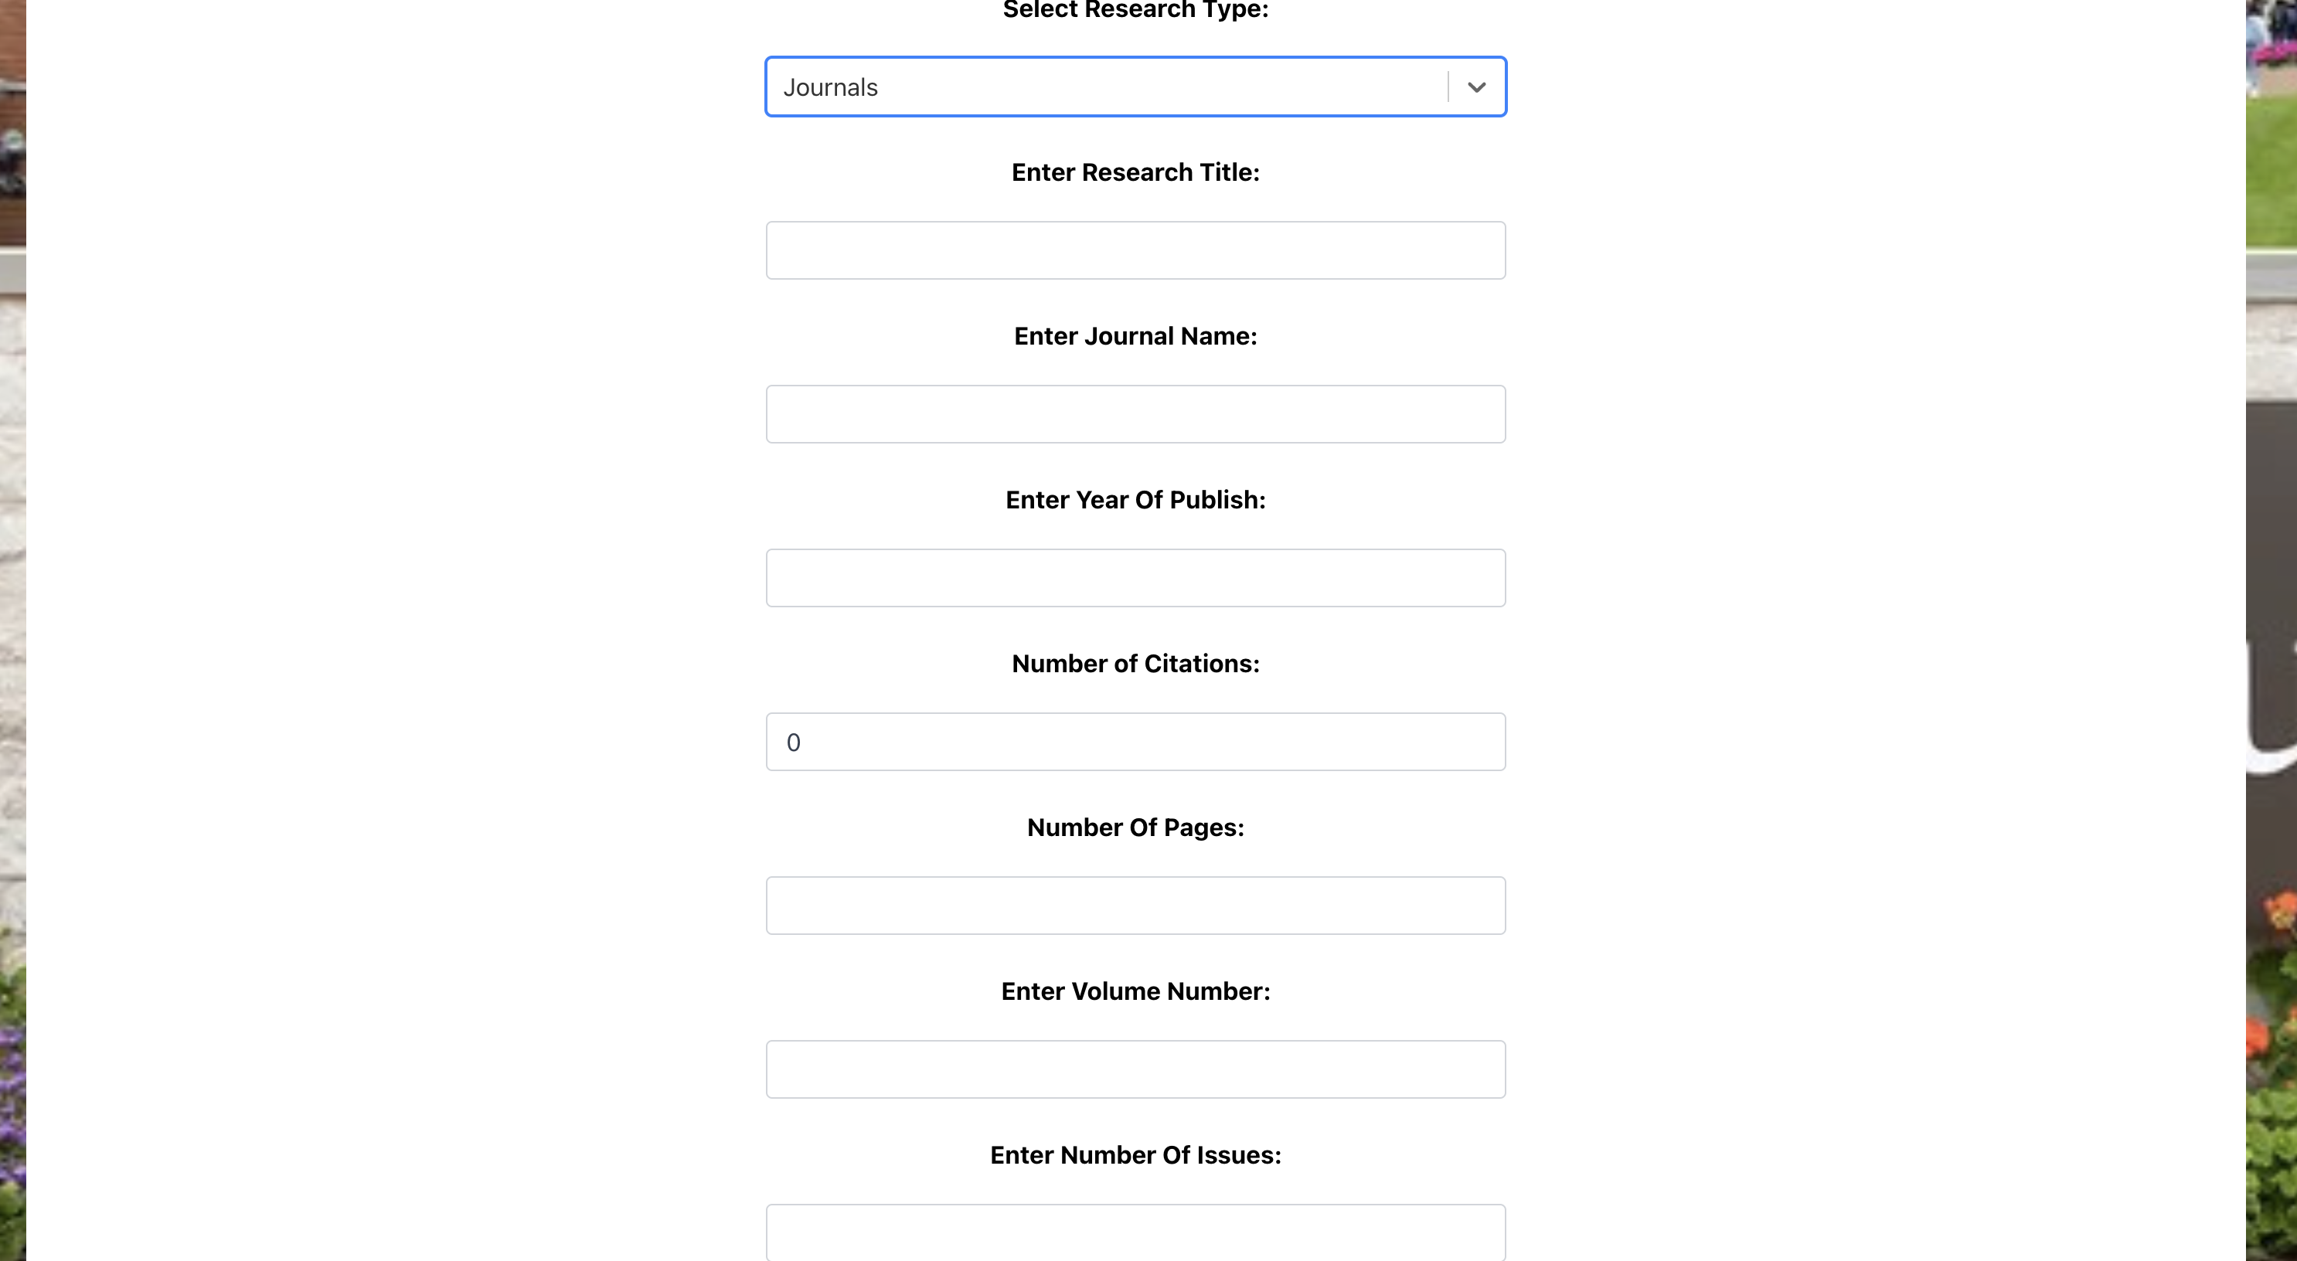


Slide 21
